Slide 1

SlugPath
January 17, 2018
Project Release Plan
Team Slugstras
Team members:
Joven Pableo (Product Owner)
Cameron Skaggs
Pranav Salunke
Srijitha Somangili
Evan Blank
Edward John Tagaca (Scrum Master)

Slide 2
SlugPath
Project Release Plan
Living on-campus and ever wonder what the fastest route to get from your dorm/apartment to OPERS? Also how long would it take? Fear not, SlugPath is here to guide you! SlugPath is an online navigation tool for anyone on the UCSC campus that are lost or curious.
High level goal(s):
Be able to display paths that were created over time by UC Santa Cruz people
Be able to represent graph data as a readable file
Be able to organize key locations at UC Santa Cruz
Be able to collect distances and time between two locations
Be able to have a visual representation if user is going the right direction
Be able to find all nearby attractions at one location
Be able to display building maps for every building on campus
Be able to organize product user experience layout
Make the product visually appealing
Create an About page
Community submits additional known paths

Slide 3
SlugPath
Project Release Plan – User Stories
Sprint 1 user stories:
(21 Points) As a Team, we need to figure out how to represent data so that our "Slugstra" Algorithm can run efficiently.
(13 Points) As a Data Collector, I need to organize the UC Santa Cruz Map so that the program can run efficiently.
(13 Points) As a Data Collector, I need to collect distances and times between locations so that the program can run efficiently.

Slide 4
SlugPath
Project Release Plan – User Stories
Sprint 2 user stories:
(5 Points) As an HTML Developer, I need to organize the website so that I can provide a better user experience.
(5 Points) As a CSS Developer, I need to beautify the website so that I can provide a better user experience.
(3 Points) As a User, I want to have a visual representation if I am heading the right direction so that I don't get lost.

Slide 5
SlugPath
Project Release Plan – User Stories
Sprint 3 user stories:
(13 Points) As a User, I want to create my own path so that I can enhance SlugPath more efficiently.
(1 Point) As a Developer, I need to create an About page so that I can publicize the team.

Slide 6
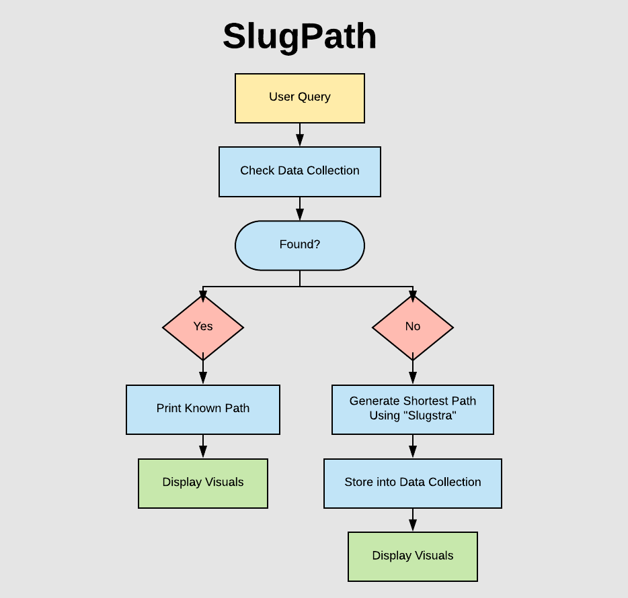
Project Release Plan – Architecture

Slide 7
SlugPath
Project Release Plan – Challenges/Risks
Challenge 1:
Creating a dynamic algorithm so that we won’t have to run shortest path algorithm such as Dijkstra's algorithm for each user query

Slide 8
SlugPath
Project Release Plan – Challenges/Risks
Challenge 2:
Representing graph data on a readable file for algorithm run on

Slide 9
SlugPath
Project Release Plan – Challenges/Risks
Challenge 3:
Visualizing shortest path on Leaflet which is a new technology for us

Slide 10
SlugPath
Project Release Plan – Technologies
Technology 1:
HTML
CSS
Javascript

Slide 11
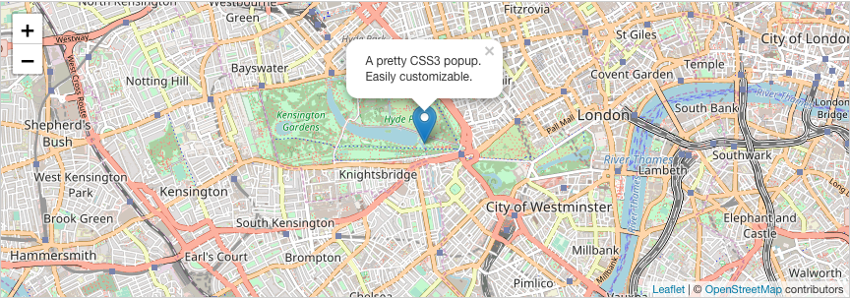
SlugPath
Project Release Plan – Technologies
Technology 2:
Leaflet
Image source via: http://leafletjs.com/

Slide 12
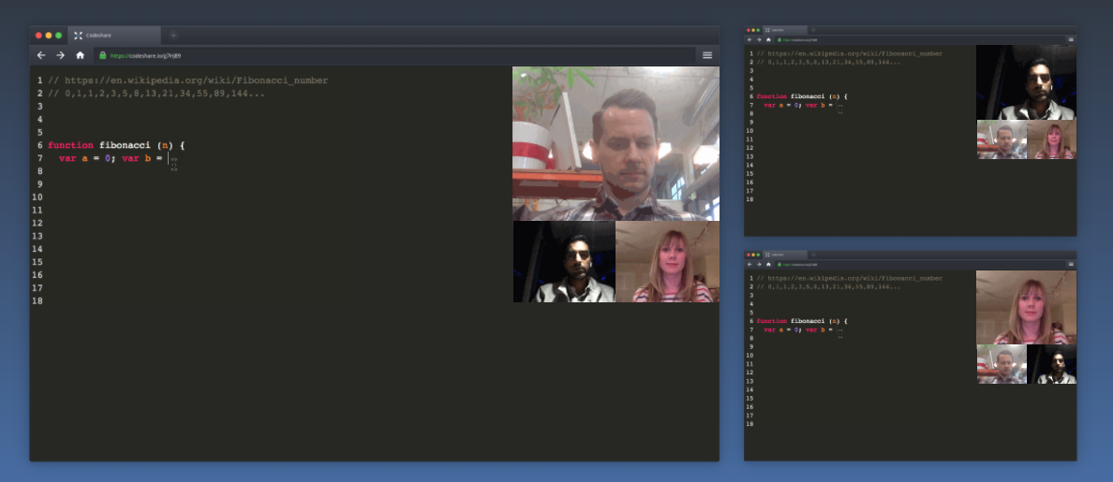
SlugPath
Project Release Plan – Technologies
Technology 3:
Codeshare.io
Image source via: https://codeshare.io/

